Slide 1
Microsoft Azure
Einführung
Peter Kirchner Technical Evangelist Microsoft Deutschland GmbH

Slide 2

Microsoft Azure
Portale
Management, Preview
PowerShell
Cmdlets
Xplat-CLI
SDKs
.Net, Java, PHP, Python
RESTful
direkt
RESTful Management API
Services
skalierbar
hochverfügbar
hybrid
offen
sicher
Microsoft Cloud Infrastruktur

Slide 3





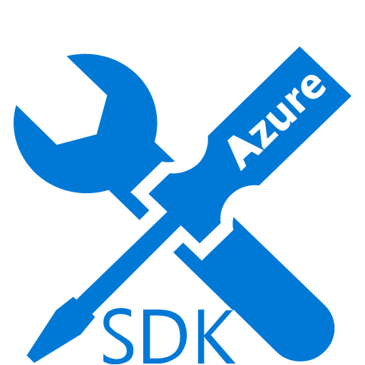
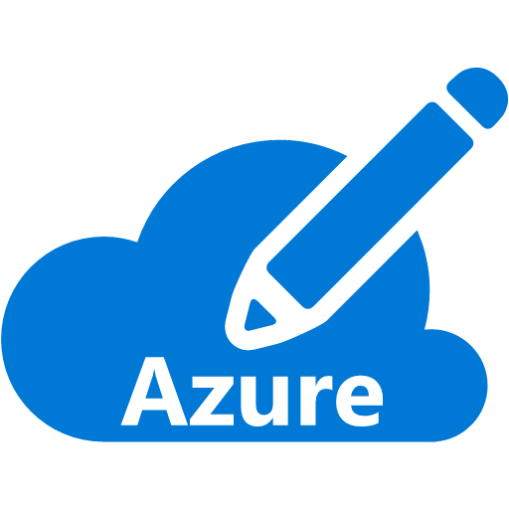

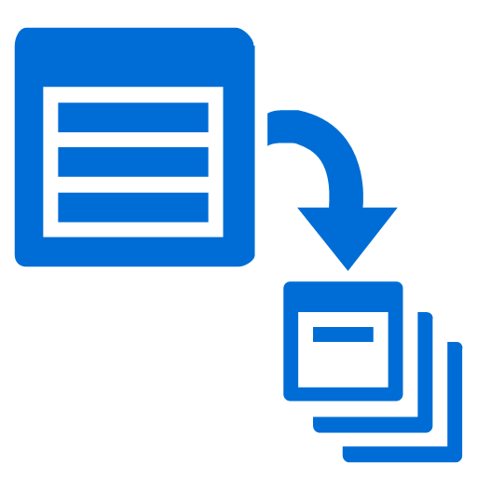

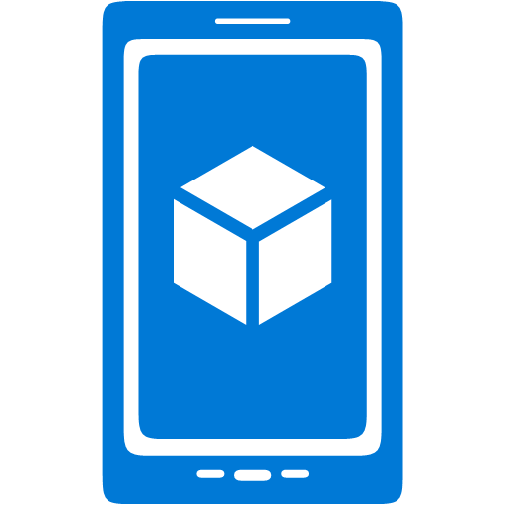











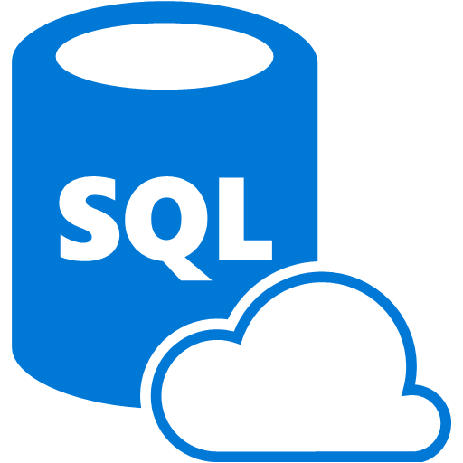









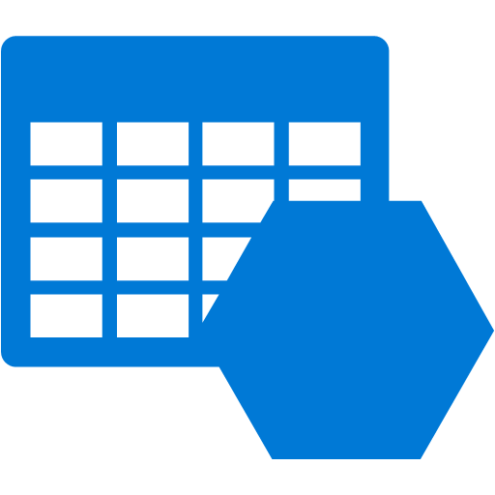










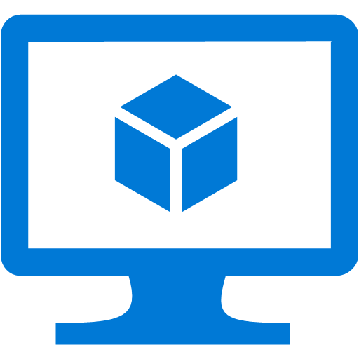








Platform Services
Security & Management
Compute
Web and Mobile
Developer Services
Hybrid
Operations
Cloud
Services
Service
Fabric
Web Apps
API
Apps
API
Management
Visual Studio
Azure SDK
Portal
Azure AD
Connect Health
Batch
Remote App
Mobile
Apps
Logic
Apps
Notification
Hubs
Team Project
Application
Insights
Active
Directory
AD Privileged
Identity
Management
Multi-Factor
Authentication
Integration
Analytics & IoT
Data
Backup
Storage
Queues
Biztalk
Services
Automation
HDInsight
Machine
Learning
SQL
Database
SQL Data
Warehouse
Operational
Insights
Hybrid
Connections
Service
Bus
Key Vault
Data
Factory
Event
Hubs
Redis
Cache
Search
Import/Export
Store /
Marketplace
Media & CDN
Site
Recovery
Stream
Analytics
Mobile
Engagement
DocumentDB
Tables
VM Image Gallery
& VM Depot
Media
Services
Content Delivery
Network (CDN)
StorSimple
Infrastructure Services
Compute
Storage
Networking
Virtual Machines
Containers
BLOB Storage
Azure Files
Premium Storage
Virtual Network
Load Balancer
DNS
Express
Route
Traffic Manager
VPN Gateway
Application Gateway
Datacenter Infrastructure (24 Regions, 22 Online)

Slide 4
Exkurs: Dienstmodelle
On-Premises
IaaS
PaaS
SaaS
Applications
Data
Users
Middleware
Operating System
Virtualization
Hardware
Networking
Physical Security
Customer
Provider

Slide 5
Exkurs: Cloud Computing nach NIST
National Institute of Standards and Technology
Special Publication 800-145 (2001)
Wesentliche Charakteristika
On-demand self-service
Broad network access
Resource pooling
Rapid elasticity
Measured service

Slide 6
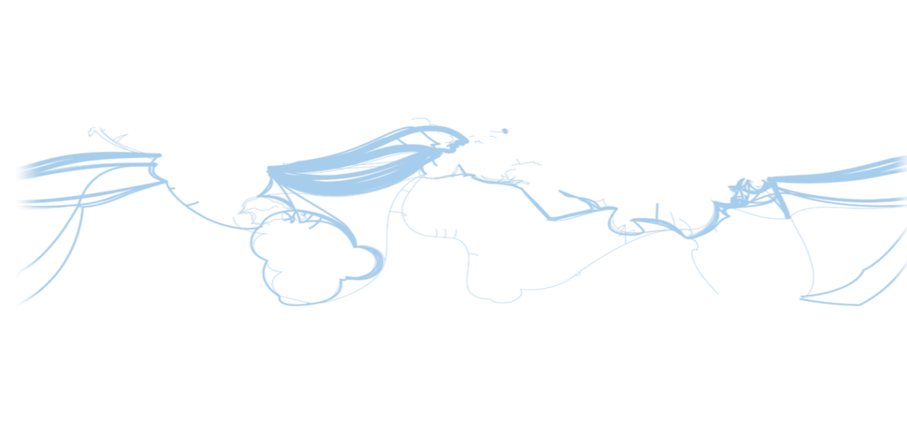
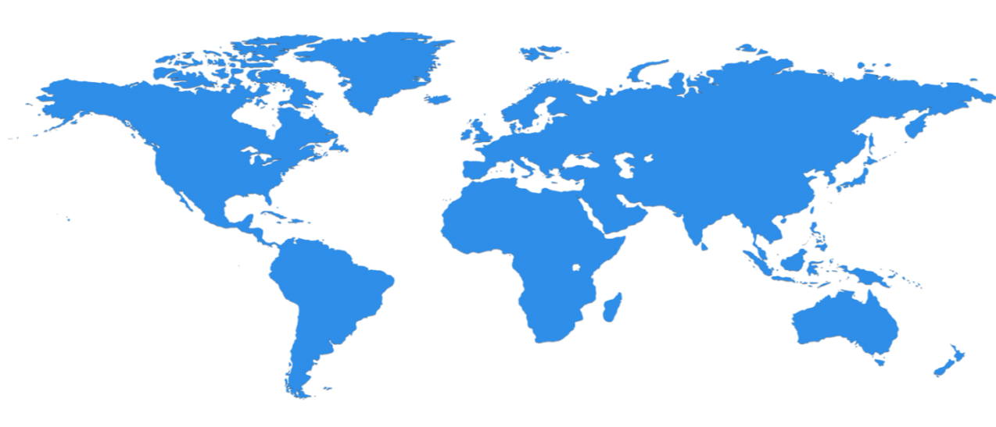

Globale Infrastruktur
24 Regions Worldwide, 22 ONLINE
North Central US
Illinois
North Europe
Ireland
West Europe
Netherlands
Central US
Iowa
Canada Central
Toronto
Canada East
Quebec City
US Gov
Iowa
China North *
Beijing
China South *
Shanghai
Japan East
Saitama
West US
California
East US
Virginia
India Central
Pune
Japan West
Osaka
South Central US
Texas
East US 2
Virginia
US Gov
Virginia
India South
Chennai
India West
Mumbai
East Asia
Hong Kong
SE Asia
Singapore
Australia East
New South Wales
Brazil South
Sao Paulo
Australia South East
Victoria
Operational
Announced/Not Operational
* Operated by 21Vianet

Slide 7
Speicher für (un-)strukturierte Daten
RDBMS in VM SQL
Oracle
MySql
SQL Database Basic
Standard Premium
DocumentDB
Table Storage
Blob Storage
Files
Disks & Drives
RDBMS
NoSQL (Dok)
NoSQL (K-V)
BLOB (Block/Page)
Filesystem
3-fach redundante Speicherung
TDS
RESTful
NTFS
Volle SQL Funktionalität
Maximale DB-Größe 16 TB
Auto-Setup und Clustering
Maximale DB-Größe 500GB
Objekt-Datenbank
Semi-strukturierte JSON-Objekte
NoSQL-DB
Große, semi-strukturierte Daten
Große Binärdaten (Videos, Bilder, Audio, …)
SMB File Share für VMs und Cloud Services
Basiert auf Blob-Storage
Persistentes FS für VMs und Cloud Services
Basiert auf Blob-Storage

Slide 8


Virtual Machines
Azure Loadbalancer
Anwender
Cloud Service /
Ressourcen-
gruppe
Virtual Machine
Hosting von Hyper-V-VMs
Gruppierung über Cloud Services & Ressourcengruppen
Lastbalancierte Endpunkte
Disks in VMs werden in Storage persistiert
Ausnahme: Local Disc (D:)
Alternativen für die Erstellung:
Erstellung eigener VMs (lokal)
Auswahl aus einer VM Gallery
Verbindung von VMs mit On-premises
über das Virtual Network
Mobilität der VMs
von On-Premises in die Cloud und zurück
Virtual Machine
Local Disc
Application
Schreib- Lese-Zugriffe
Images
Storage
Kopie in
Storage
Data VHD
OS VHD
Sysprep & Capture
Upload
Eigene VHD oder Image

Slide 9
Azure Resource Manager
Classic model (v1)
Resource Manager (v2)
Cloud service
Resource group
Load balanced
endpoint with IP address
Back-end pool (NICs)
VM with IP address
Storage account
VM
NIC
VM IP address
VNet
Load Balancer
LB IP address
Disk (blob)
Subnet
Reference
Reference
Reference
Virtual network
Reference
Storage account
Virtual network
Storage account
Depends on
Reference
Disk (blob)
Subnet-1
Network Security Group ACLS
(deployed to VM, NIC, or Subnet)

Slide 10
Azure Resource Manager Templates
Azure Templates can:
Ensure Idempotency
Simplify Orchestration
Provide Cross-Resource Configuration and Update Support
Azure Templates are:
Source file, checked-in
Specifies resources and dependencies (VMs, WebApps, DBs) and connections (config, LB sets)
Parametrized input/output
SQL-A
Website
Instantiation of repeatable config.
Configuration → Resource Group
[SQL CONFIG] VM (2x)
DEPENDS ON SQL
DEPENDS ON SQL
SQL - A
Website
Virtual
Machines
SQL
CONFIG

Slide 11
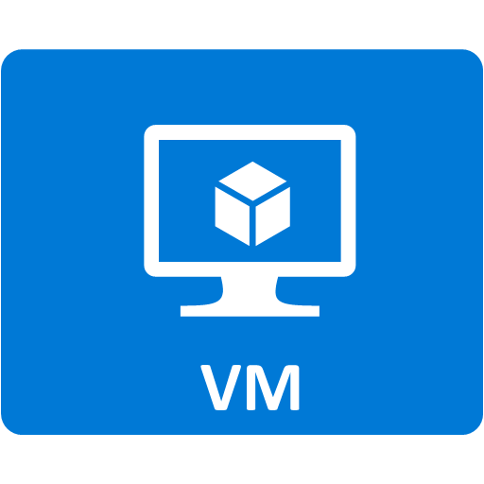


Beispiel eines ARM-Templates
On-Prem / RZ
Off-Prem / Cloud
PIP1:80
DC
IIS
Linux LAMP
PIP2:80
SQL
Client

